Slide 1
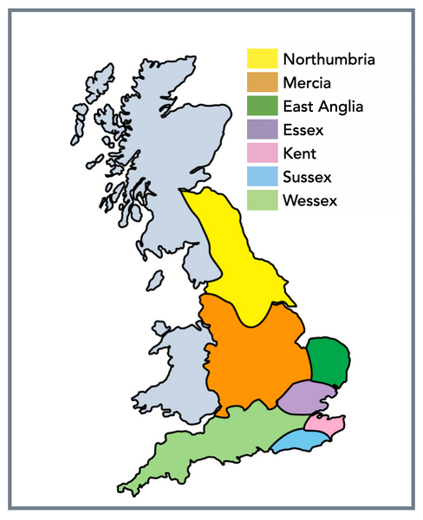
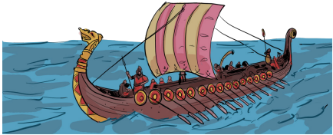
My country the UK
The Anglo- Saxon and Viking struggle for England
This term we will be focusing on the history of our country, specifically the Anglo-Saxon and Viking struggle. We will focus on understanding the chronology of events, making comparisons to different time periods and understanding our knowledge comes from various kinds of sources.
Key vocabulary
Chronology | The sequence of events or dates in the order of their occurrence
Anglo- Saxon | A Germanic inhabitant of England between the 5th century and the Norman conquest
Angles | Germanic invaders from the Danish/ German border conquered most of roman Britannia
BC | Before Christ/ BCE- before the common era
AD | Anno domini (Latin for the last year of the lord)/ CE- common era
Civilisation | The society, culture and way of life of a particular area
Archeologist | A person who studies human history and prehistory through the excavation of sites and the analysis of artefacts and other physical remains
Settlement | A place where people establish a community
Monastery | A building or buildings occupied by a community of monks living under religious vows
Migration | The movement of a person/ people from one country, locality or place of residence to settle in another.
Viking | Scandinavians who raided or invaded the coasts of Europe between the 8th and 10th centuries.
Danelaw | The laws in place in the part of England held by the Danes before the Norman conquest
Sticky learning
To understand the Anglo-Saxon struggle for England up to the time of Edward the confessor.
To compare and contrast the way Anglo-Saxons and Vikings lived with the modern day.
To develop a chronological understanding of British history.
To understand that our knowledge of the past is constructed from a range of sources and compare them to modern day Britain.
To learn about key historical figures such as, Alfred the great, Athelstan the first king of England and Edward the confessor.

