Slide 1

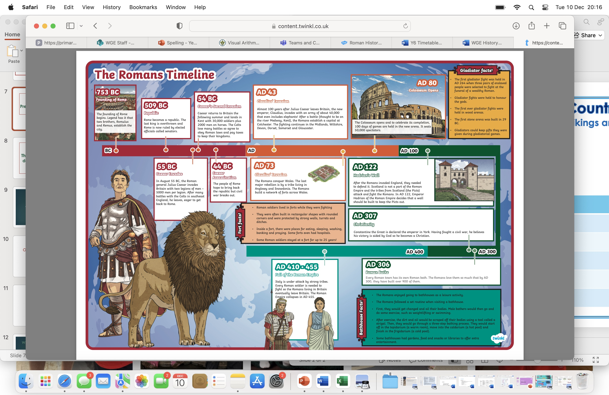
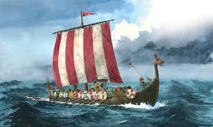
My Country – The UK (Year 4)
Who were the Anglo-Saxons and Vikings and why did they invade and settle in Britain?
In year 4, we focus and understand the Viking and Anglo-Saxon struggle for England, up to the time of Edward the Confessor. We consider the trends and contrast them with the Roman invasion of Britain around 500 years earlier, which they learnt about in Year 3. We look at a range of sources and compare them with the accuracy that we have in modern day Britain.
Key Questions
What was life like in England after the fall of the Roman Empire?
Who were the Anglo Saxons and why did they settle in Britain?
Who were the Vikings and why did they carry out the raids on Anglo Saxons ?
Where did the Vikings settle and who was in control of England at the time?
How did England change after the settlement of the Anglo Saxons and Vikings?
Vocabulary
Vikings | warriors from northern Europe
Ancient | very old, or having existed for a long time.
Conquest | taking control of a country or city through the use of force.
Archaeologist | scientists who study the history of humans by looking at what man-made objects were left behind.
Legacy | Something that’s happened in the past.
kingdom | A country or territory ruled by a king or queen
BC/AD | BC is the dates before the birth of Jesus. The bigger the number BC, the longer ago in history it was.
Anglo- Saxons | A group of farmer-warriors who lived in Britain over a thousand years ago.

Slide 2
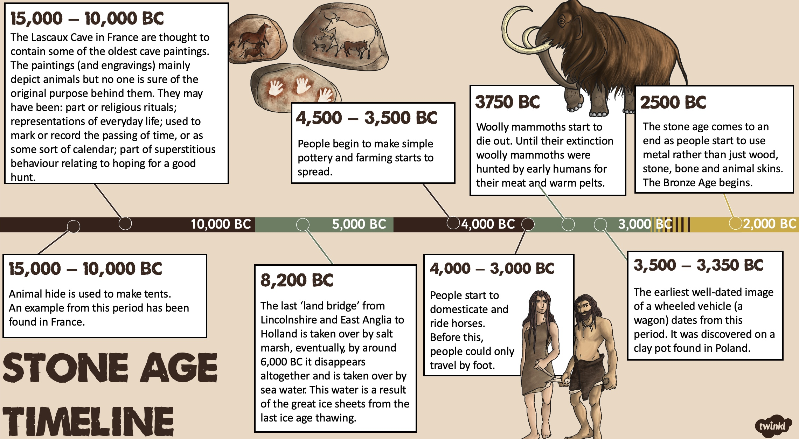
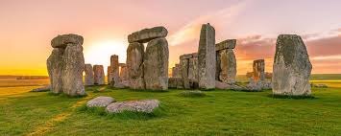
My Country – The UK (Year 4)
In year 4, we also learn about the Stone Age and make comparisons between living now and then. They will make some links between and across periods, such as the differences between clothes, food, buildings or transport and identify where some periods fit into a chronological framework by noting connections, notable individuals, trends and contrasts over time.
Key Questions
What was life like in England during the Neolithic and Mesolithic Era? How is this different to how we live?
How did tools develop over the Neolithic era?
How did life change from Stone Age to Iron Age?
What was life like for people in the North West during the Bronze Age?
How has the development of tools impacted on modern day?
Vocabulary
thatched | Thatching is the craft of building a roof with dry vegetation
Hunter gatherer | A member of a nomadic group who hunt or harvest food that grows in the wild.
Stone Age | A broad prehistoric period during which stone was widely used to make stone tools
Henge | A prehistoric circular or oval earthen enclosure.
Scandinavia | A region in norther Europe made up of 3 countries Denmark, Norway, and Sweden
Chronology | The arrangement of dates and events in the order they occurred.
Sources | Evidence that human beings have left of their past activities
Settlement | A place where people establish a community

