Slide 1
Little Wandle

Slide 2
Phonics

Slide 3
What is phonics?
Phonics is the process in which we teach children to decode and segment words
Decoding (reading – but different to being ‘a reader’)
Teaches children to recognise and say the individual sounds that they see in words and how to blend the sounds together to read words.
Segmenting (spelling)
Teaches children to break up the sounds they hear in words and represent the sounds in the correct order with graphemes (letters)

Slide 4
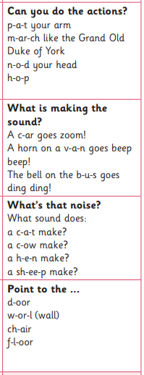
Phonics in Nursery
Aims to ensure children are well prepared to link sounds to letters and blend sounds together at the start of Reception.
A balance of child-led and adult-led experiences. Activities include ‘What’s in the box?’ and oral and oral blending (robot talk) games.
Developing an awareness of sound, focused listening and attention and oral blending.
Aviod
Teaching letter names
Incorrect pronunciation of sounds (video to come)
Focusing on the grapheme (letter)

Slide 5
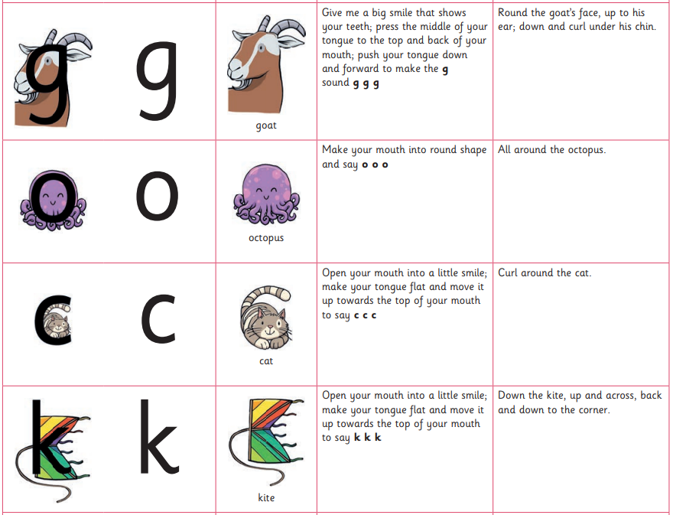
What does the phonics session look like in Reception?
Whole class 30 minute session includes:
Revisit the sounds we already know (flashcards)
Introducing a new sound (focus on pronunciation - video)
96 sounds to learn during the course of Reception and Year 1
Reception - 44 new sounds
Year 1 - 52 alternatives (flashcards)
Reception have currently learnt 15 sounds – including today
New sounds of the week are sent home each Friday
What’s in the box? (Practise pronunciation)

Slide 6
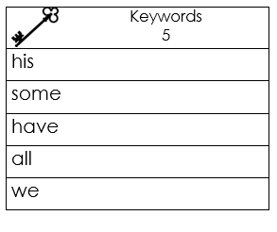
- Introducing the grapheme (letter)
Associated mnemonic (picture clue) and writing phrase
- Oral blending (robot talk)
- Teacher led and independent reading (blending video)
Tricky words – eg. the, said, have
Additional tricky words (keywords)
12 sets
Practise at home
Practise with an adult in school each Wednesday
Keep track at the back of the children’s reading record

Slide 7
- Segmenting (spelling)
- Finish with an oral blending (robot voice) game
Phonics in provision (play)
Adult led activities
Enhancements
Rainbow challenges

Slide 8
Reading

Slide 9
Reading in Nursery
Repeated experiences of high-quality texts with planning. 4 sessions per week:
Session 1 – Reading the text to the children including key criteria
Session 2 – Pick out the verbs, actions and joining in
Session 3 – Pick out the nouns, making sentences
Session 4 – Acting out the story
Include nursery rhymes, action songs, poems and songs in each session
A copy of the book will be placed in the reading area for the children to access independently.

Slide 10
How we teach reading in Reception
Once your child is able to blend the sounds they know together to read words they will be allocated a reading group (assessment before October half term)
6 children per group – all children have the same book matched to their ability
The same book will be assigned to your child every Monday via eBooks to practise at home
Adult led sessions
3 sessions per week – Mon, Tues, Thurs (flexible)
Session 1 - Decoding (word accuracy, phonics, decoding, blending)
Session 2 - Prosody (expression which shows understanding)
Session 3 – Comprehension (answering questions about what they have read)
It is the re-reading of books which will help to develop your child as a fluent, skillful reader.

Slide 11
Reading at home in Nursery
Recommended book list on Seesaw – vocabulary
Techniques for reading with your child:
Share your passion and enthusiasm when reading – discuss your favourite books
Build anticipation – provide children with snippets of information about the book before you read
Pause reading - give them chance to talk and make comments
- Encourage the children to join in with repeated refrains (such as ‘Run, run, as fast as you can’)
Use different voices for different characters
Trigger the children’s curiosity and invite their participation by ‘wondering aloud’ (for example, say: I wonder why that happened?)
Read stories over and over again. Hearing words repeated is crucial to children learning new language

Slide 12
Reading at home in Reception
Your child is expected to engage with two types of books at home (amongst others forms of reading)
Practise book
Their reading book assigned via eBooks.
Same as the book your child is reading in school.
They read to you - This is a chance to show off their reading skills.
They should be able to read the book, it has been matched to their ability via teacher assessment.
If they struggle with a word just tell them what it is.
Teach reading in school, practise at home.
Ebook link
Reading records

Slide 13
Sharing book
A book from the library your child has chosen (Fridays)
Age appropriate.
You read to them – countless benefits!!
They may recognise a few words in the book – celebrate this.
High quality texts
It is the enjoyment of reading which helps to develop your child as a lifelong reader. Research shows that children who truly read for pleasure have greater academic success.

Slide 14
Managing ‘homework’ in Reception

Slide 15
Please send your child’s reading wallet containing their reading record and keywords to school everyday as part of the morning routine. They will place their reading wallet into their group basket each morning, it is helpful to have it out of their bag before they come through the door.
Keywords – Wednesday (new words) Sunday (Mid week practise) Tuesday (night before change)
Practise book (eBook) - Monday (beginning) Thursday (mastered!)
Library book – Bedtimes! Please send back to school each Friday
Phonics sound sheet – Look out for opportunities. Keep at home.

