Slide 1
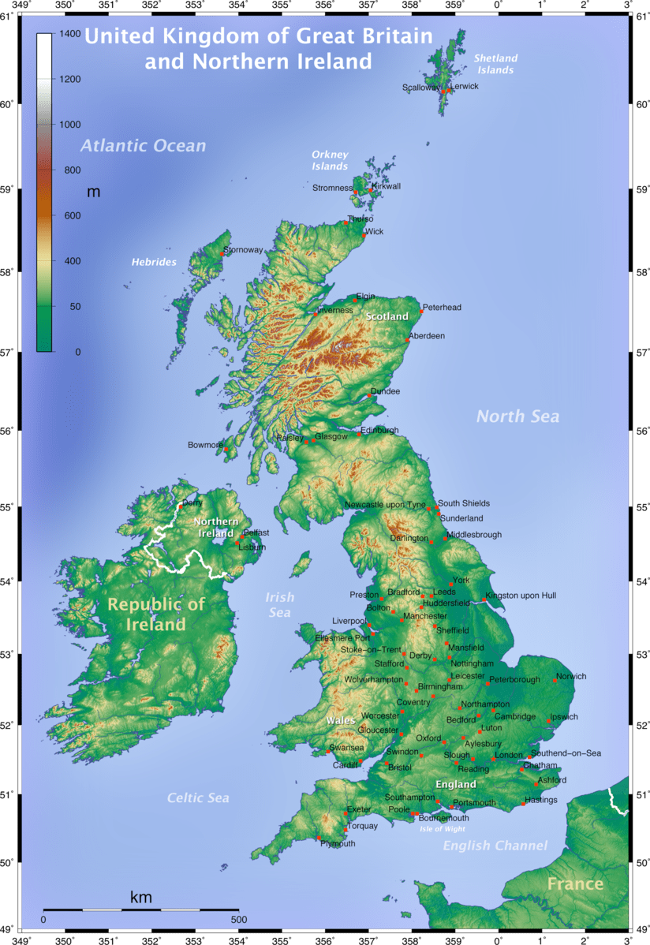
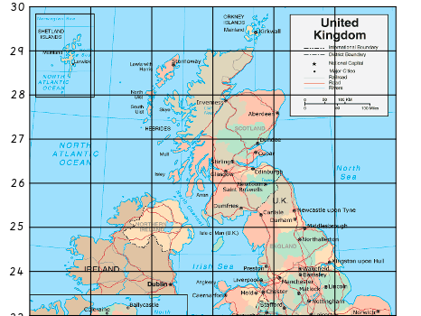
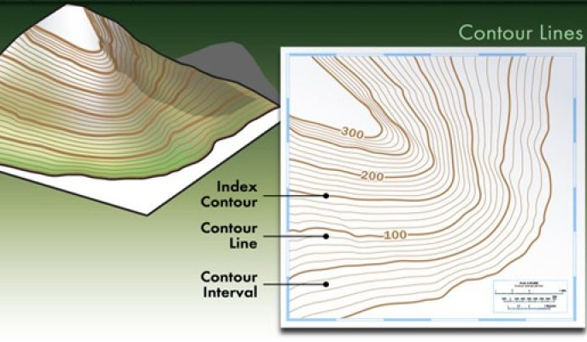
My Country - The UK
Vocabulary
Climate | The general weather pattern over a long period of time.
Biomes | An area which is classified according to the species that live in that location.
Region | An area, especially part of the country or the world that has common features.
Terrain | An area of land that has different physical features.
Wetlands | A place in which the land is covered by water, either permanently or seasonally.
Latitude | This measures the distance north or south of the equator.
Longitude | This measures the distance east or west of the equator.
Vegetation | The ground cover provided by plants.
County | A county is a territorial division of some countries, usually forming a local government.
Contour lines | Lines on a map that show the lands height above sea level.
This Geography topic will be focusing on our country – The UK. We will be learning about the different geographical regions and identifying what makes each region ‘unique’. They will learn about the different biomes, climate zones, vegetation belts, rivers and mountains of the UK. We will also be exploring our country on different maps.
Sticky Learning
To know and locate different countries of the UK.
To know that within the UK there are different climate zones, depending on the region or country.
To know about the different vegetation across the UK.
To know how to apply map reading skills to locate counties and countries of the UK.
To know how to use an atlas and digital mapping (Goggle maps)

